Slide 1

ChatSonic
Group 9:
Abdulrahman Almyman–
Hisham bin Huwaimel –

Slide 2


Preface
What is polynomials ?
An expression which is the sum of terms of the form where n is a nonegative integer is a polynomial.

Slide 3
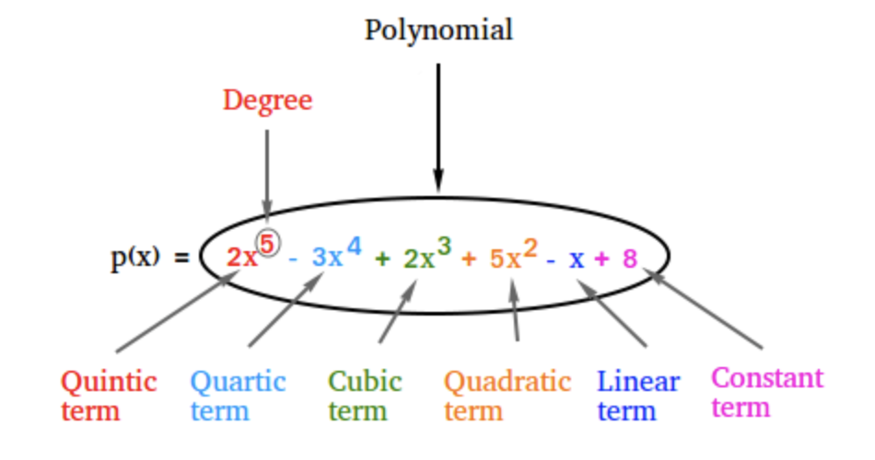
Types of polynomials

Slide 4
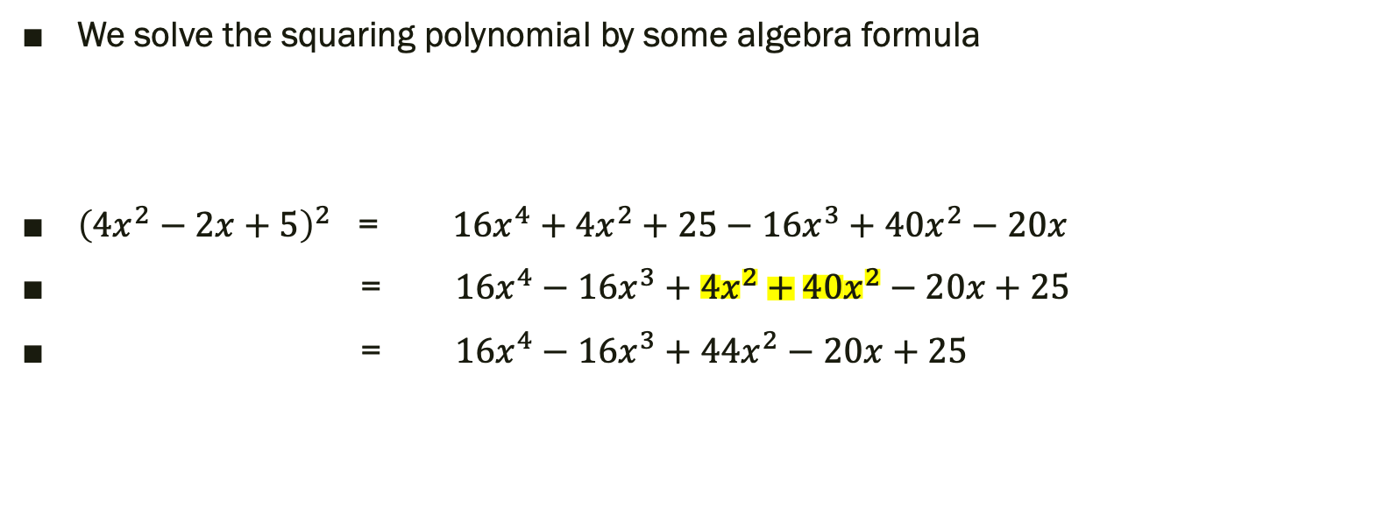
Squaring a Polynomial
We solve the squaring polynomial by some algebra formula
${\left(4x^{2}−2x+5\right)}^{2}$ = $16x^{4}+4x^{2}+25−16x^{3}+40x^{2}−20x$
= $16x^{4}−16x^{3}+4x^{2}+40x^{2}−20x+25$
= $16x^{4}−16x^{3}+44x^{2}−20x+25$

Slide 5
Paragraph:
In mathematics, a square-free polynomial is a polynomial defined
over a field (or more generally, an integral domain) that does not have
as a divisor any square of a non-constant polynomial.
A univariate polynomial is square free if and only if it has no multiple root in
an algebraically closed field containing its coefficients.
This motivates that, in applications in physics and engineering,
a square-free polynomial is commonly called a polynomial with no repeated roots

Slide 6
Paragraph:
In the case of univariate polynomials, the product rule implies that, if p2 divides f, then p divides the formal derivative f ' of f.
The converse is also true and hence,
f is square-free if and only if 1 is a greatest common divisor of the polynomial
and its derivative.

Slide 7
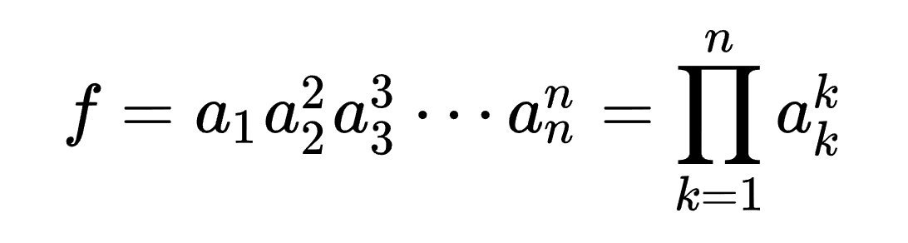
Paragraph:
A square-free decomposition or square-free factorization of a polynomial is a factorization into powers of square-free polynomials

Slide 8
Paragraph:
where those of the a_{k} that are non-constant are pairwise coprime square-free polynomials (here, two polynomials are said coprime is their greatest common divisor is a constant; in other words that is the coprimality over the field of fractions of the coefficients that is considered).
Every non-zero polynomial admits a square-free factorization, which is unique up to the multiplication and division of the factors by non-zero constants.

Slide 9
Paragraph:
The square-free factorization is much easier to compute than the complete factorization into irreducible factors, and is thus often preferred when the complete factorization is not really needed, as for the partial fraction decomposition and the symbolic integration of rational fractions.
Square-free factorization is the first step of the polynomial factorization algorithms that are implemented in computer algebra systems. Therefore, the algorithm of square-free factorization is basic in computer algebra.

Slide 10
Paragraph:
Over a field of characteristic 0, the quotient of f by its GCD with its derivative is the product of the ai in the above square-free decomposition. Over a perfect field of non-zero characteristic p, this quotient is the product of the ai such that i is not a multiple of p.

Slide 11
Paragraph:
Further GCD computations and exact divisions allow computing the square-free factorization In characteristic zero, a better algorithm is known, Yun's algorithm, Its computational complexity is, at most, twice that of the GCD computation of the input polynomial and its derivative.
if Tn is the time needed to compute the GCD of two polynomials of degree n and the quotient of these polynomial by the GCD, then 2Tn is an upper bound for the time needed to compute the square free decomposition.

Slide 12
Yun's algorithm
Yun's algorithm described for the square-free decomposition of univariate polynomials over a field of characteristic 0.
It proceeds by a succession of GCD computations and exact divisions.
The input is thus a non-zero polynomial f, and the first step of the algorithm consists of computing the GCD a₀ of f and its formal derivative f'.

Slide 13
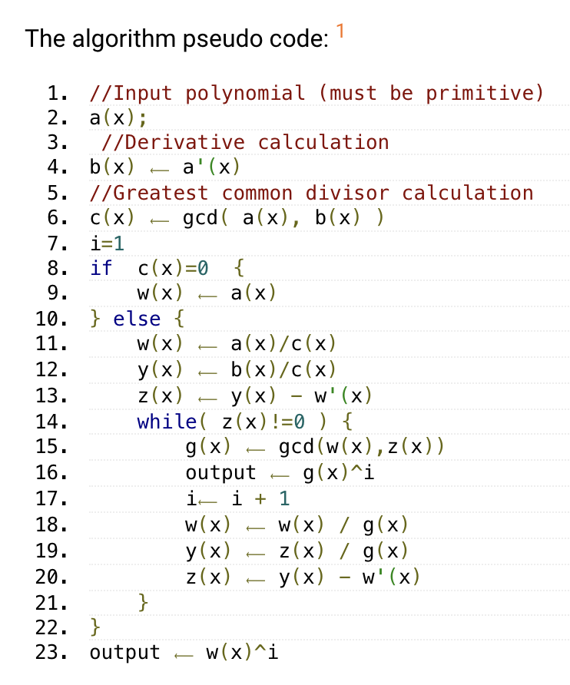
Yun square-free factorization algorithm
A univariate square-free polynomial p(x) has no square factors: q²(x), where q(x) - positive degree polynomial.
this code calculator factorizes an input polynomial into square factors if any.

Slide 14
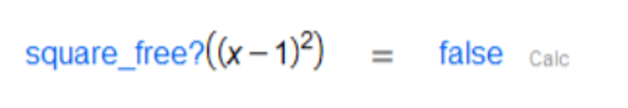
Examples:

Slide 15
Examples:

Slide 16
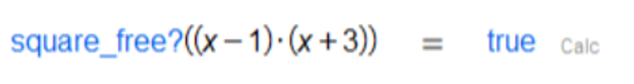
Examples:

Slide 17
Examples:

Slide 18
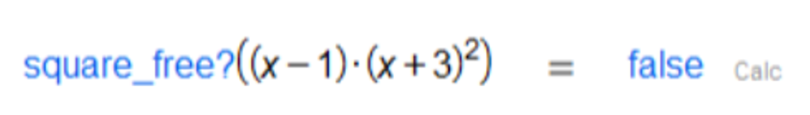
Examples:

Slide 19
Examples:

Slide 20
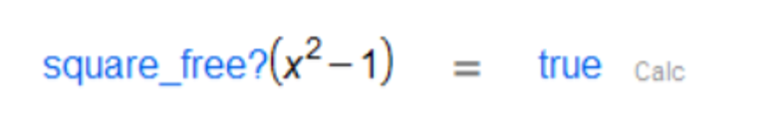
Examples:

Slide 21
Examples:

Slide 22
Thank you for listening
Muaid Shunaif Almutairi –
Hisham bin Huwaimel –

